Slide 1
Shannon Data
2019-06-25
Data from Cell 2019-06-19-21 and cell 2019-07-11-14

Slide 2
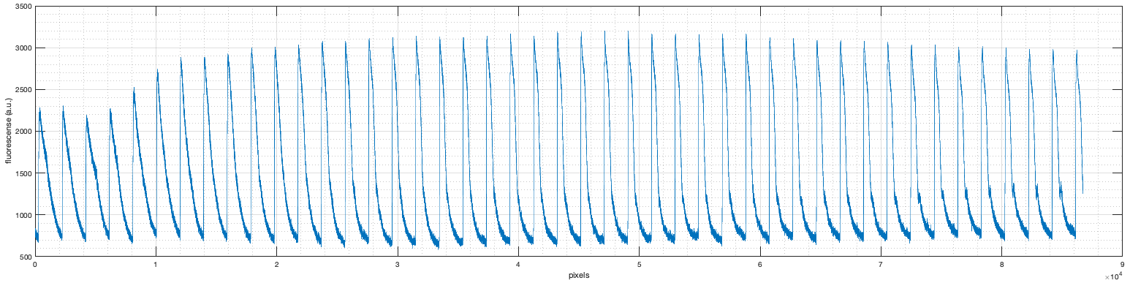
Whole cell Ca transients (F/F0) from the analyzed cell in this PowerPoint (i.e. the fluorescence is the average of a line which is the full cell length). All data here came from this image.
2 μM ISO

Slide 3
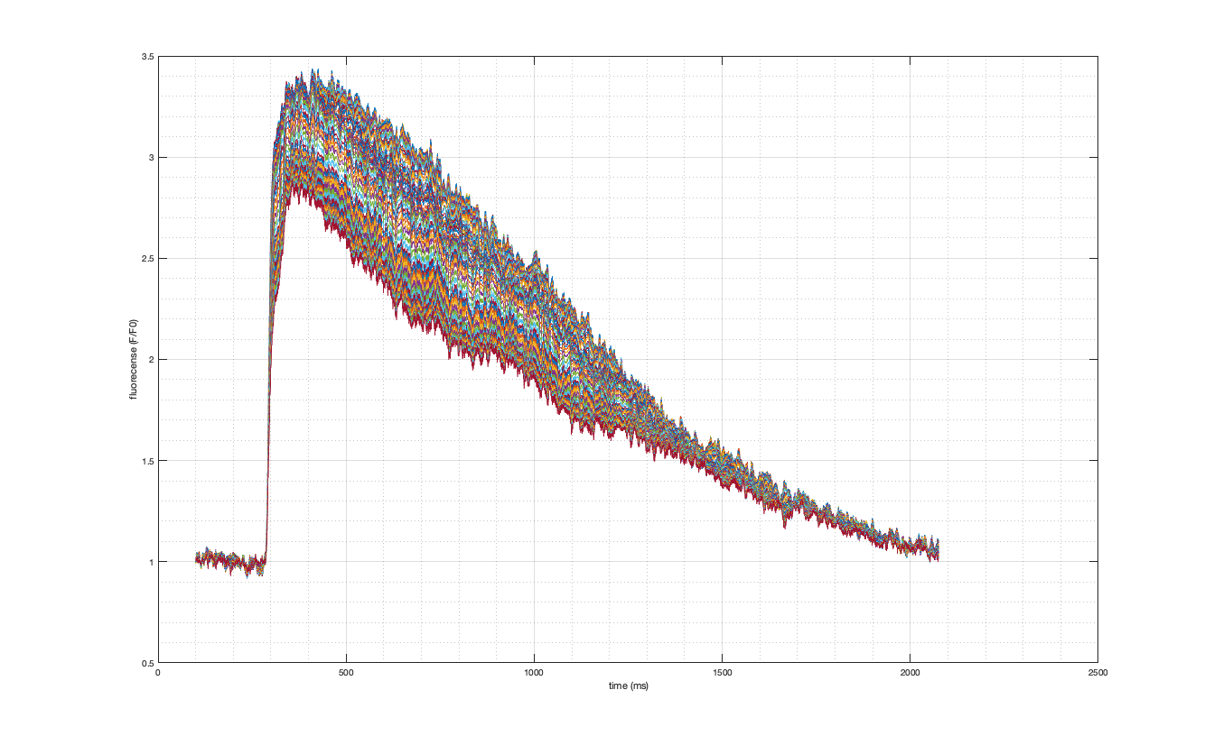
Pre-ISO Ca transient
[Ca] (F/F0)
Time (ms)
Notes:
The data was taken from a line longitudinally across the full cell length.
This is a full pre-ISO cell transient. Each line represents the average of a 25 μm band. The analysis averaged the fluoresce in a band near the ISO end of the cell, then moved 1 pixel over and averaged another 25 μm band. So the analysis is really more of a moving average (box car filter), pixel by pixel, across the line.
This is one of our best cells (i.e. the one I’d currently put on a poster as being “typical”).

Slide 4
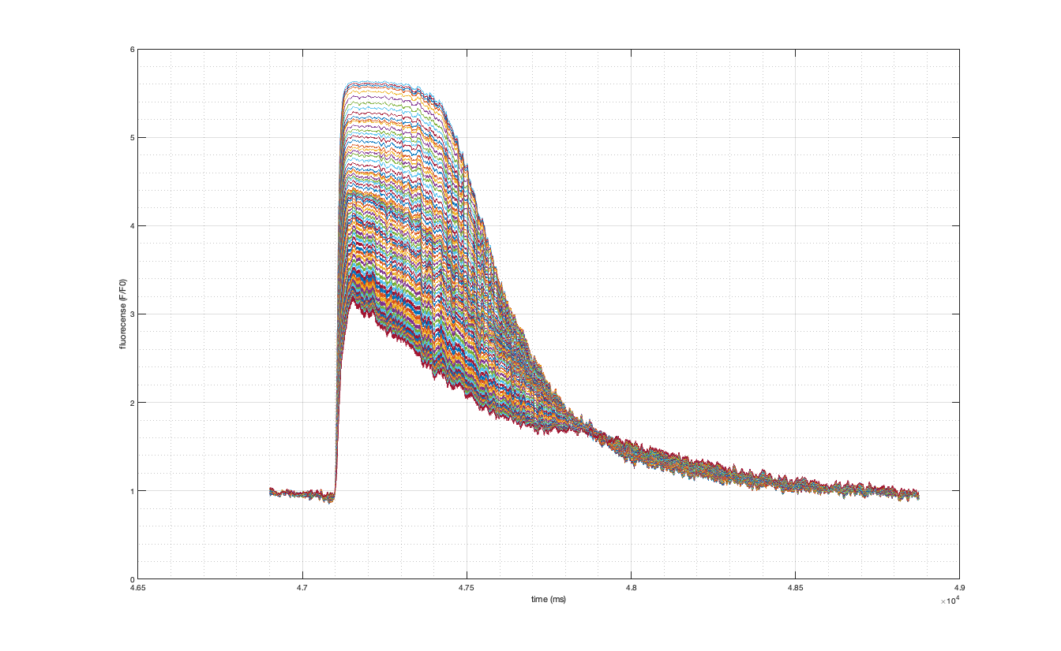
42 seconds Post-ISO Ca transient
Closest to the ISO End of the Cells
[Ca] (F/F0)
Farthest away from the ISO end of the cell
Time (ms)
Notes:
This is the same cell as the previous slide after ISO administration. Note the increased peak [Ca] and accelerated decline in the part of the cell closest to the ISO pipette. The end farthest away from the pipette has barely changed.

Slide 5
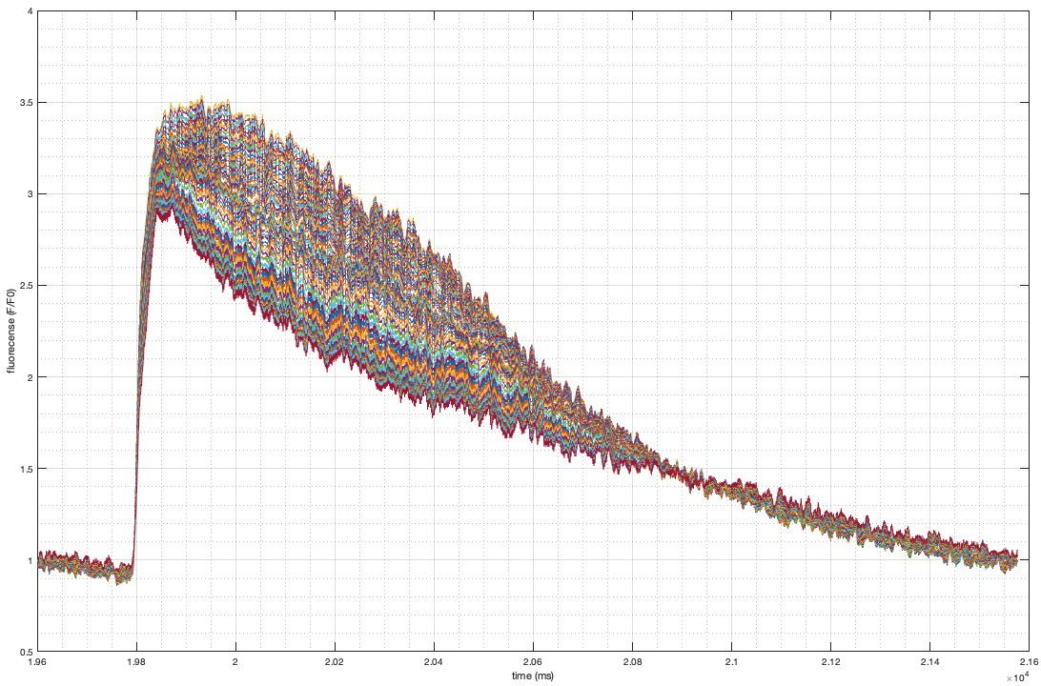
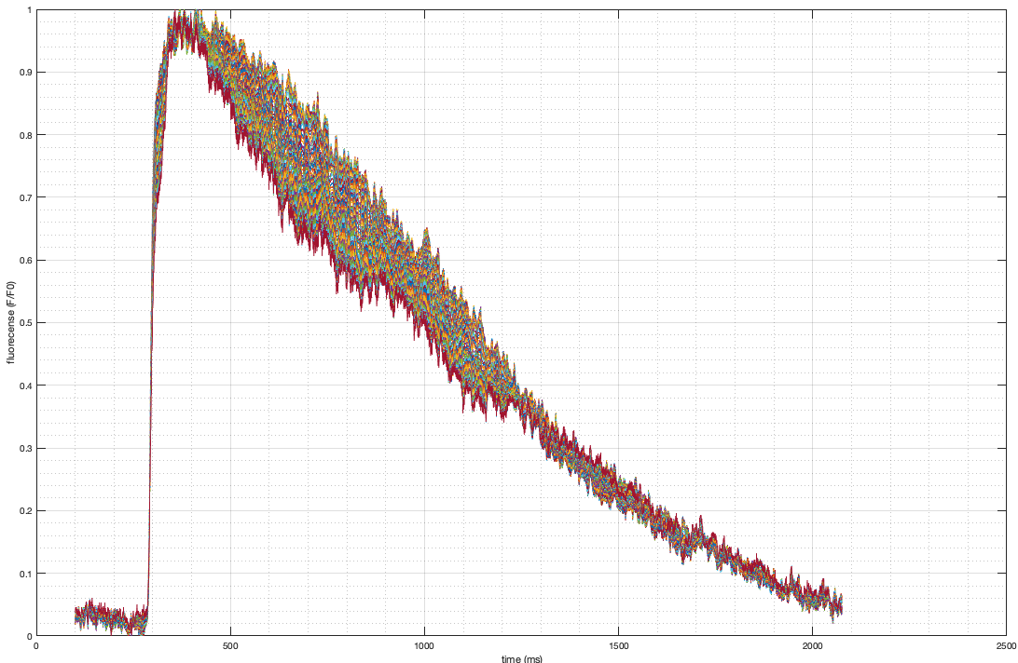
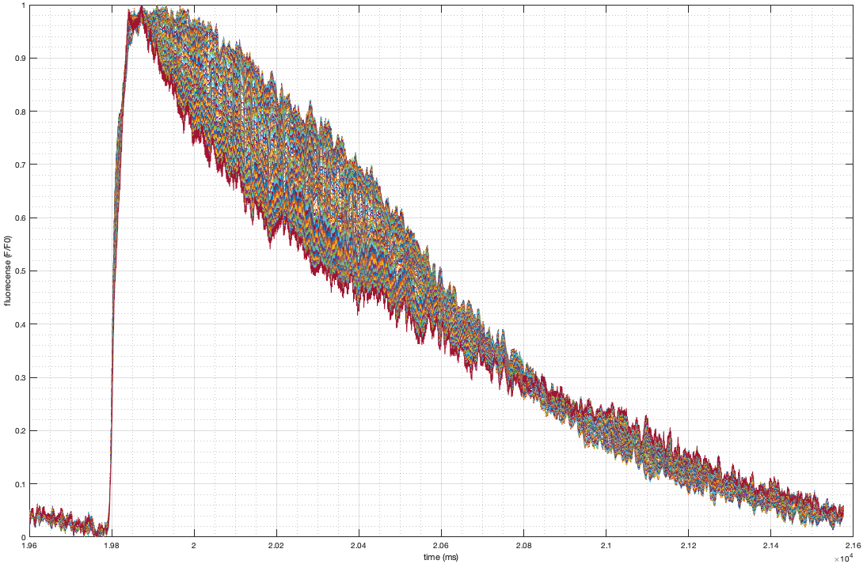
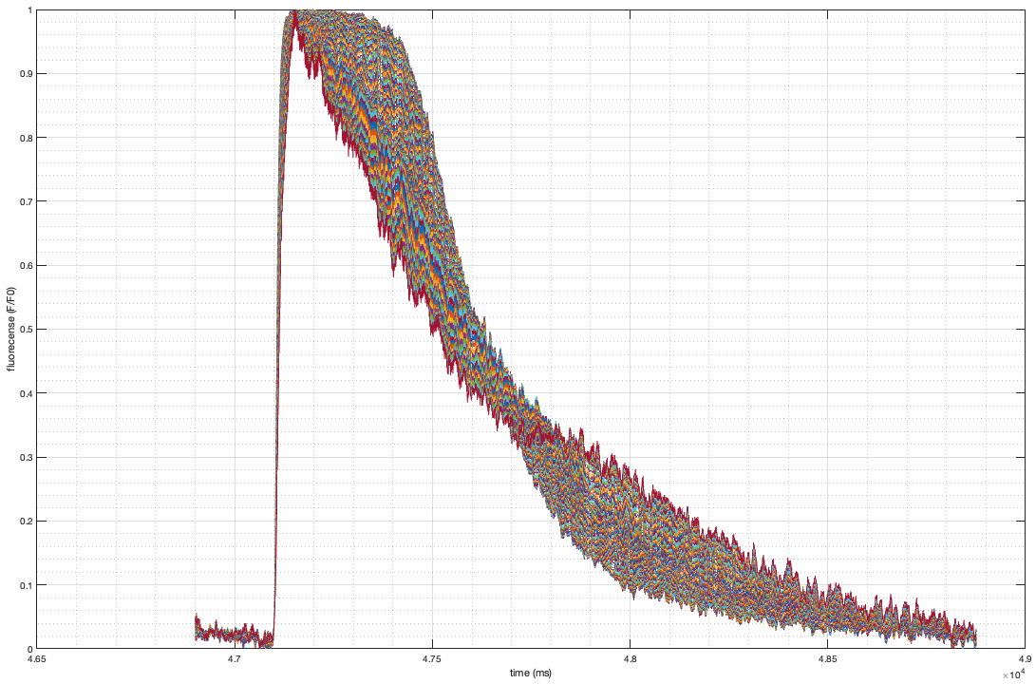
Not normalized to peak (top)
Pre-ISO
14 seconds post-ISO
42 seconds post-ISO
Normalized to peak (bottom)
Notes:
This is the same cell. Ca transients on the top, normalized to peak [Ca] on the bottom. Note the increased spread in the declines 14 seconds after ISO in the normalized transient.

Slide 6
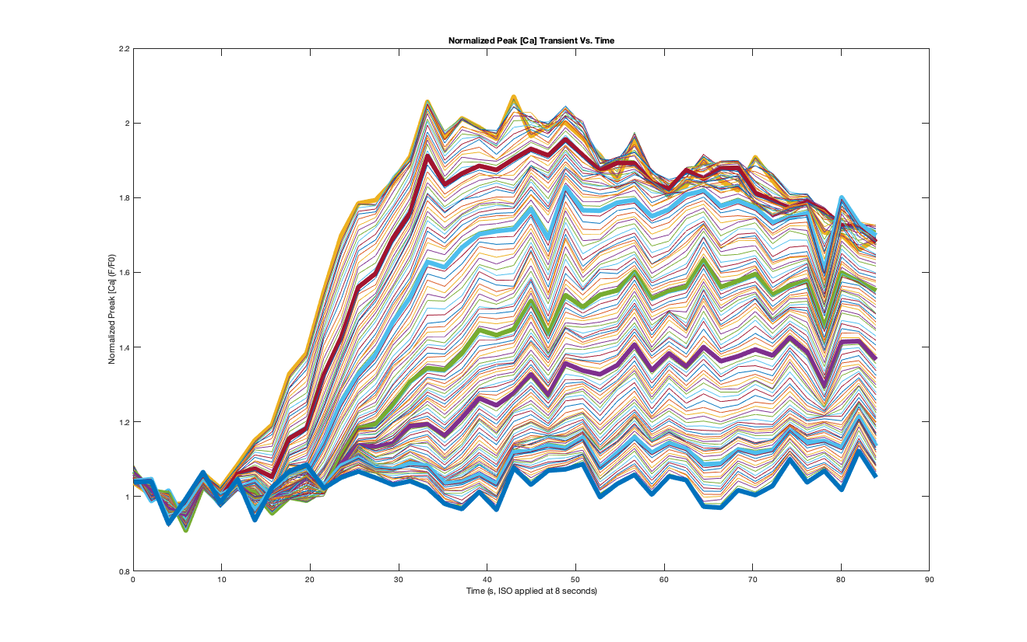
Normalized Peak Ca transient over Time
59 μm from ISO end
68 μm from ISO end
78 μm from ISO end
88 μm from ISO end
98 μm from ISO end
113 μm from ISO end
Normalized Peak [Ca] (F/F0)
120 μm from ISO end
2 μM ISO
Time (s)
Notes:
Each line on this plot represents a 25 μm band that is the indicated distance from the ISO end of the cell. The increased transient on the ISO end is relatively rapid and robust. You get a gradual delay in the response and it seems to be slower the farther you get away from this end. There is basically no response 100 μm from the ISO end.
We are very puzzled as to why the non-ISO end doesn’t eventually respond. We expected it to be delayed but we also expected equilibration of Ca to take place to at least some extent. The peak [Ca] on the ISO end does eventually decrease with time and this is commonly seen. This could be part of diffusion into the more distant parts of the cell but its very limited and there appears to be a permanent standing gradient.

Slide 7
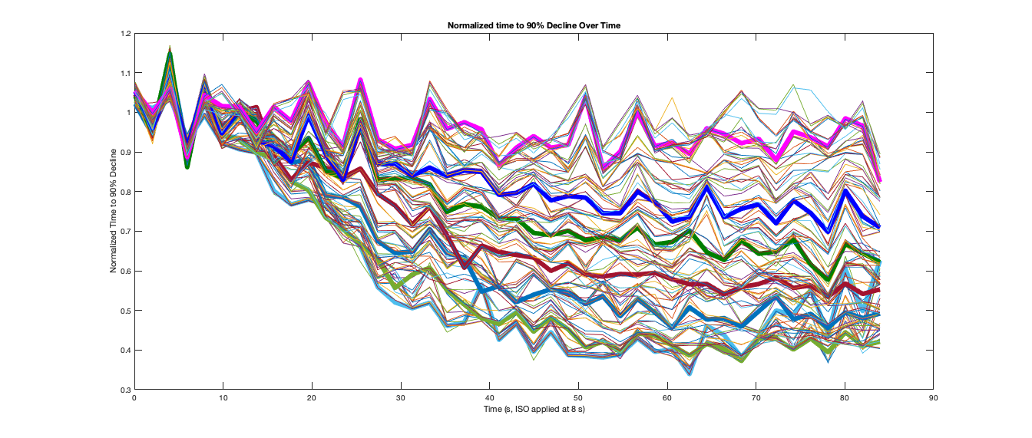
Normalized Time to 90% Decline over Time
115 μm from ISO end
Normalized Time to 90% Decline
100 μm from ISO end
90 μm from ISO end
80 μm from ISO end
70 μm from ISO end
58 μm from ISO end
48 μm from ISO end
Time (s)
2 μM ISO
Notes:
As with the previous slide, each line on this plot represents a band that is the indicated distance from the ISO end of the cell.
This data is a bit noisy but its obvious that the reduction in time to 90% decline is far more rapid and robust on the ISO end of the cell.
Again, there is is basically no response a little over 100 μm from the end. I thought that even if Ca diffusion was limiting, the time of decline would still be reduced if the AKAP (or whatever) was traveling all the way up the cell. Its obvious that at least part of what is limiting is in the second messenger system.

Slide 8
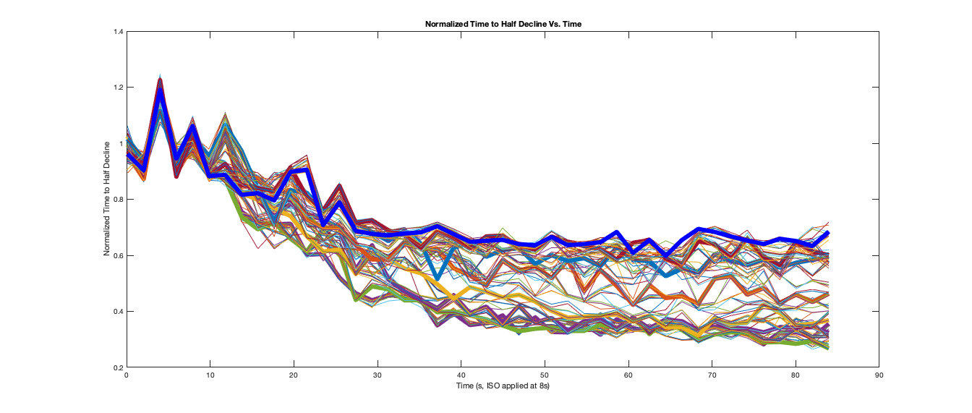
Normalized Time to 50% Decline over Time
100 μm from ISO end
90 μm from ISO end
80 μm from ISO end
Normalized Time to 90% Decline
70 μm from ISO end
60 μm from ISO end
40 μm from ISO end
29 μm from ISO end
2 μM ISO
Time (s)
Notes:
Like the previous slide but we’re measuring time to half decline. There seems to be more of a response here on the non-ISO end of the cell but there’s still a standing gradient rather than eventual complete equilibration of the response.
Note that we reliably see the difference in time to 90% decline in good experiments but we see the difference in time to 50% decline only in the “best” cells.

Slide 9
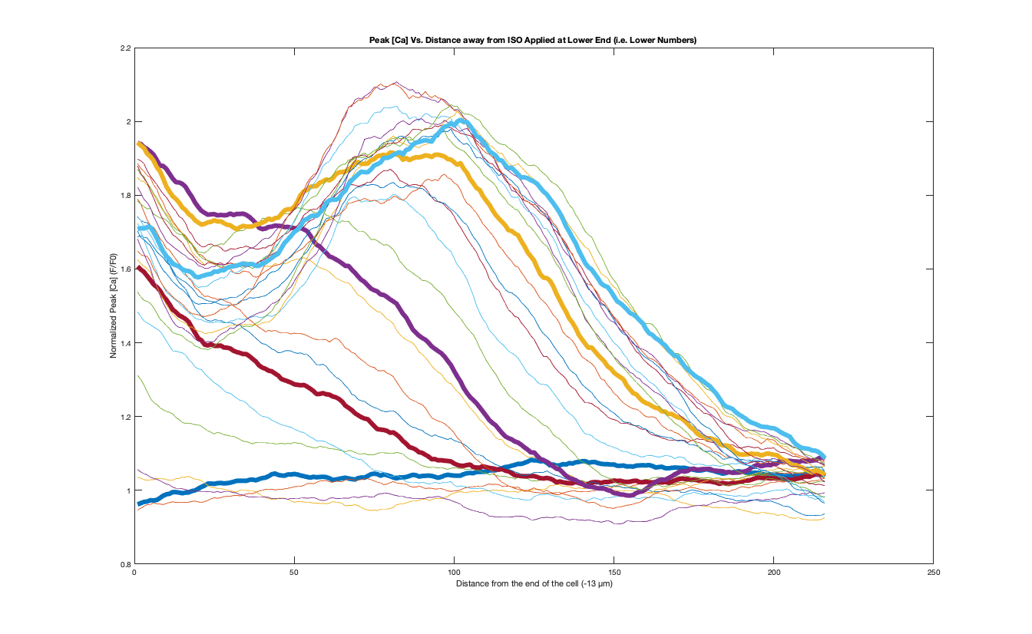
Peak [Ca] over Distance
26 s after ISO
46 s after ISO
Normalized Peak [Ca]
Pre-ISO
6 s after ISO
14 s after ISO
Distance from ISO End of the Cell (pixels)
13 μm from end
113 μm from end
Notes:
This is the same cell. Each line represents a different time after ISO and the X axis is distance from the ISO end in pixels. Each pixel is a little less than a half a micron.
Note the early increase in the transient peak on the ISO end, then the peaks gradually increase on down the line in the direction of the non-ISO end over time. The non-ISO end never increases at all.

Slide 10
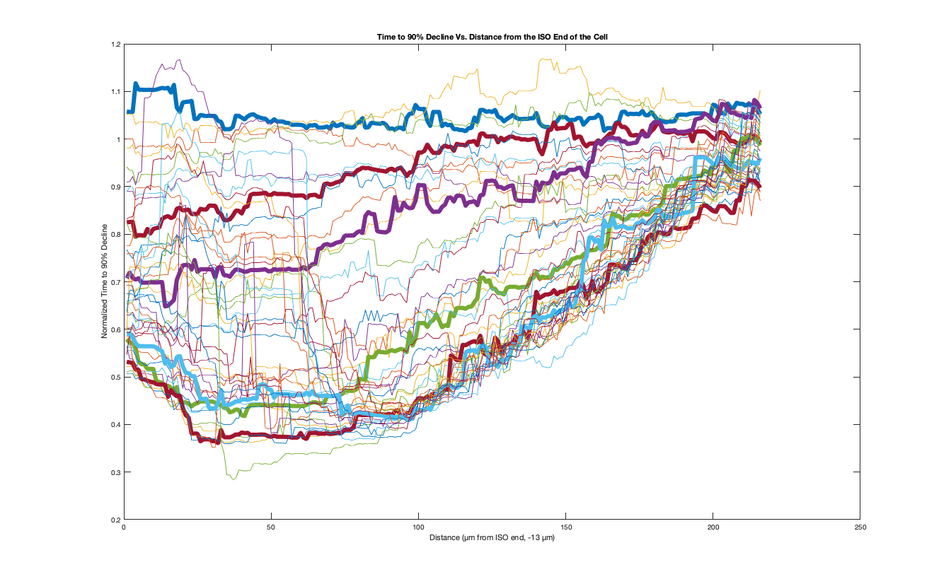
Time to 90% Decline over Distance
14 s after ISO
Pre-ISO
6 s after ISO
Normalized Time to 90% Decline
60 s after ISO
30 s after ISO
48 s after ISO
Distance from ISO End of the Cell (pixels)
13 μm from end
113 μm from end
Notes:
Same as the previous slide but now we’re doing time to 90% decline. Same result. There is a early and deep decrease in the parameter on the ISO side (6 s. in red) that gradually travels across the cell. Again there is a standing gradient rather than equilibration of the response.

Slide 11
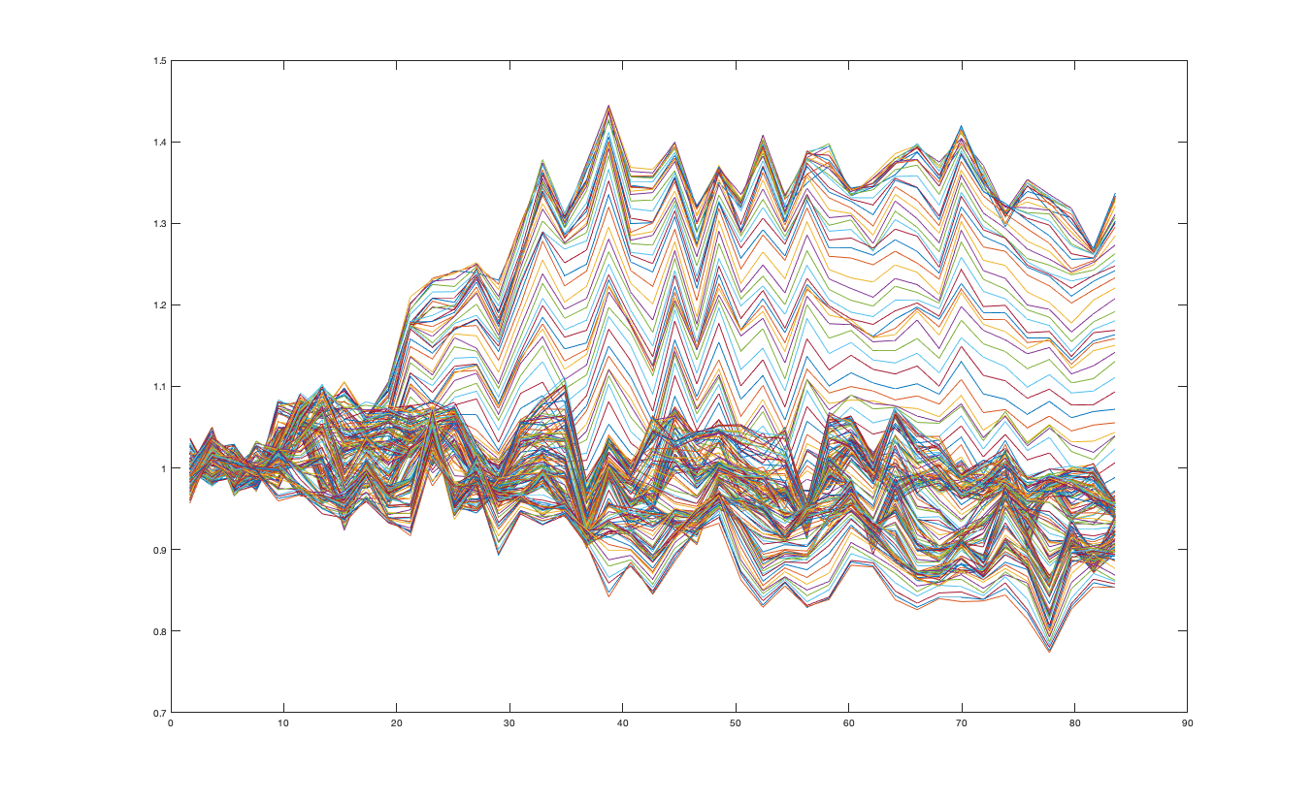
Notes:
Normalized transient peak over time. Same protocol with 4 mM Ca and no ISO in the pipette and 1 mM Ca outside the cell. I don’t know why the baseline declines on this one but its not a consistent feature. Note that, unlike the ISO data, these bands all rise at the same time with no delay. Only the new steady-state peak appears to vary with distance.
Need to figure out how much of this is due to the box car smooth.

Slide 12
Questions to consider:
Why doesn’t the response equilibrate? Is there an immobilized part of the second messenger system that is limiting transfer of the response over distance?
Even if the second messenger response isn’t traveling, why doesn’t the Ca equilibrate more? You would think you would get more of a transient increase in the non-ISO part of the cell, especially if diffusion in the SR is faster than the cytosol, don’t you think?
Next steps with fresh cells?

